Slide 1



DATA AMBASSADOR PROGRAM WORKSHOP
April 5, 2024

Slide 2
WELCOME!
WIFI:
Password:
Go to: https://cookcountyhealthatlas.org
Notes:
Will update with login info once on site

Slide 3
AGENDA FOR TODAY
Welcome and icebreaker
Introduction to the Cook County Health Atlas
Health Atlas Activity 1 - Exploring Health Indicators
Break (10 min)
Health Atlas Activity 2 - Grant Writing and Fundraising
Activity summary and additional resources
Group discussion
Next steps
Health equity and epidemiology

Slide 4
WELCOME AND ICEBREAKER
Icebreaker:
Please introduce yourself with your name, organization, and favorite app.
Notes:
Popcorn style- will choose a table to go first and have everyone go around the room by table until everyone has briefly introduced themselves

Slide 5










DATA AMBASSADOR PROGRAM
Meet the Team
Epidemiology Unit
Dr. Alfreda Holloway Beth
Director of Epidemiology
Dr. C. Scott Smith
Program Coordinator, Epidemiology
Nhan Nguyen
Epidemiologist IV
Stephanie Shosanya
CSTE Applied Epidemiology Fellow
Madison Gardner
CSTE Applied Epidemiology Fellow
Caleb King
CSTE Applied Epidemiology Fellow
Community Engagement & Health Education Unit
Technical Assistance Partner
Collaboratory for Health Justice
Alyssa DeLuca
Community Engagement
Manager
Sierra Allen
Community Mobilization Coordinator
Leslie Gates-Durr
Research Specialist
Notes:
Alyssa will introduce the team and describe the vision of the Data Ambassador Program. Those seated will be asked to stand up and wave/say hi
Alyssa will then cue Alfreda to present her slide

Slide 6

HEALTH EQUITY & EPIDEMIOLOGY
Disparities and inequalities in health outcomes and access to healthcare services among different population groups.
Health Equity Data
Population Health Surveillance
1
People
Race
Ethnicity
Gender Identity
Is there a difference between a health outcome by age, race, income, access to PCP?
2
Place
Preferred Language
Sexual Orientation
Disability Status
Are some areas more impacted by a health outcome?
3
Time
How has the health outcome changed over time?
How do we know if there are differences in health outcomes amongst people?
Notes:
SAY:
Hello, my name is Alfreda, and today, I will be discussing the concept of health equity as it relates to Epidemiology, the science of public health, and how the Cook County Health Atlas plays a crucial role in understanding and addressing health disparities in our community.“
In general, epidemiologists collect and analyze data to uncover trends and risk factors associated with different diseases. We play a critical role in understanding why certain populations may be more vulnerable to health issues.“
We use health equity data to helps us with this task. HED refers to information and statistics that are specifically related to understanding and addressing disparities and inequalities in health outcomes and access to healthcare services among different population groups. This data typically includes information on factors such as race, ethnicity, gender, and other demographic variables that can influence health outcomes. We also supplement our understanding of risk and exposure by utilizing data from external factors known as social determinants of health which include information about income, access to care, and neighborhood characteristics.
These data are used to inform policies, programs, and interventions aimed at reducing these disparities.

Slide 7
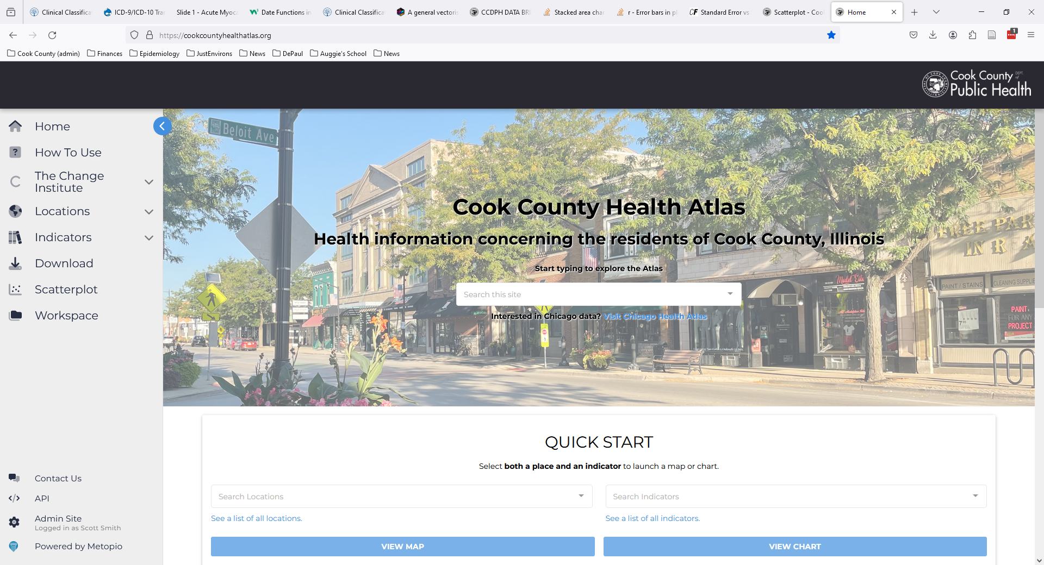
https://cookcountyhealthatlas.org/
Notes:
Thanks for this opportunity to discuss the Cook County Health Atlas. This is an image of the landing page, the home page of the Cook County Health Atlas. Similar to the Chicago Health Atlas, these web pages provide an online platform for exploring, sharing health-related information that are managed by the Cook County Department of Public Health (CCDPH).

Slide 8

HEALTH INDICATOR CATEGORIES
Indicators on the health atlas are organized into six primary categories.
HEALTH OUTCOMES
DEMOGRAPHICS
Consequences, complications and other outcomes that result from disease (e.g., injury, hospitalization, death).
Population characteristics including community size, composition and structure (e.g., population, age, gender, race/ethnicity, migration).
The platform integrates several types of information
HEALTH BEHAVIORS
SOCIOECONOMIC
Individual activities that influence health (e.g., alcohol, drug and tobacco use; diet, physical activity, sleep).
Social and economic factors that can affect health (e.g., income, employment, education, segregation).
HEALTH CARE
PHYSICAL ENVIRONMENT
Systems and services for administering care (e.g., health screenings; primary, prenatal and dental care; clinics, hospitals, FQHCs).
Characteristics of the places where individuals where individuals live, learn, work, and play (e.g., housing, air quality, water quality and transportation)
Notes:
Like everyone, the Cook County Department of Public Health (CCDPH) has access to an increasing amount of information. For local health departments, we specifically have access to more and more public health information. For example, we receive data from the federal government concerning population, housing, and air quality, the state of Illinois, concerning hospitalization visits, births, and deaths. Both the city of Chicago and suburban Cook County administer annual health surveys of their youth and adult populations. The challenge for CCDPH is to make the data accessible and useful for community-based organizations and other stakeholders. The suburban Cook County health atlas, initially launched in late 2022, is an important step toward this effort.

Slide 9
HEALTH ATLAS ACTIVITY
The activity is separated into three modules that each focus on a use case of the atlas
1
Exploring Health Indicators
Access
topic-specific pages
Search for indicators
Visualize & Stratify
indicators
Explore broader patterns of health outcomes, behaviors, and social determinants of health
2
Grant Writing & Fundraising
Create custom
maps and tables
Download data
Demonstrate need and/or build a compelling case for the potential impact of proposed initiatives
3
Time Period Comparisons
Changes in health outcomes over time
Changes in population composition over time
Create scatterplot
Comparing changes over time to identify community trends and evaluate program effectiveness.
Notes:
This presentation provides a brief overview of how specific atlas data and tools can assist with these activities.

Slide 10
HEALTH ATLAS ACTIVITY Things to Note:
Module 1 & Module 2 format with a 10 minute break in between
15 minute demonstration
15 minute exercise
2-3 minute group discussion
We’ve provided a handout to follow along with the modules
Feel free to ask questions throughout the activity & exercise!
We have designated Epidemiology team members to assist you.
Notes:
Once I’ve demonstrated that, and you will then have to time to work exercises where you simply replicate what I’ve shown you and then we’ll have a mini discussion on you’ve found and time for questions
And in order to make the activity easy to follow, we’ve provided you all with a hand out that has a short summary of the steps for each module and directions for each challenge.
*waves document in the air*
And I also want to point out through out each challenge, if your having issues with the atlas or pulling up a visualization just raise your hands and someone from the epi team will be more than happy to help you.

Slide 11
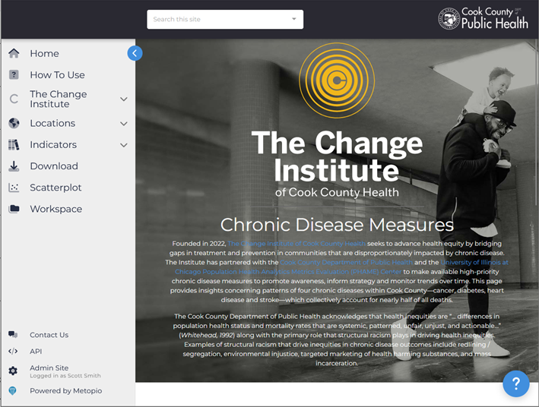
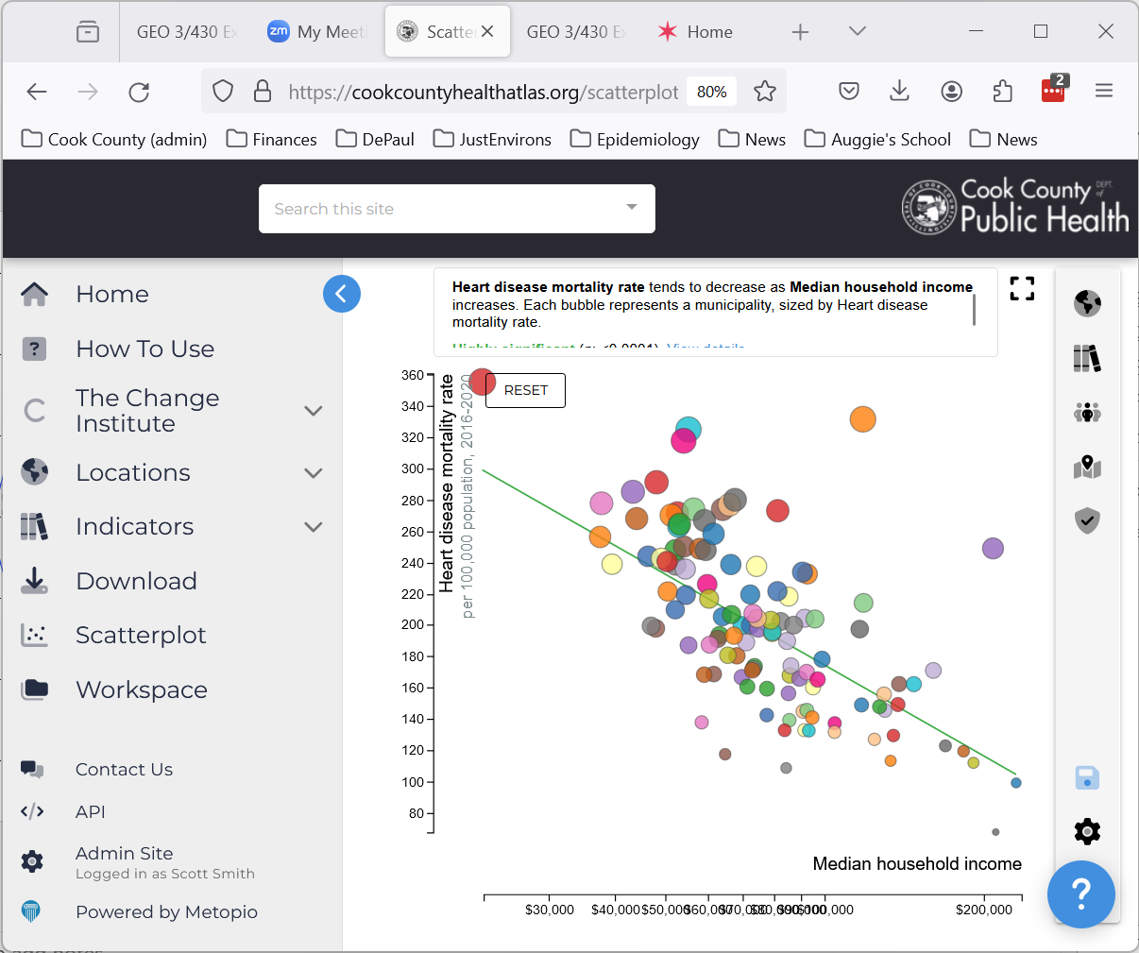
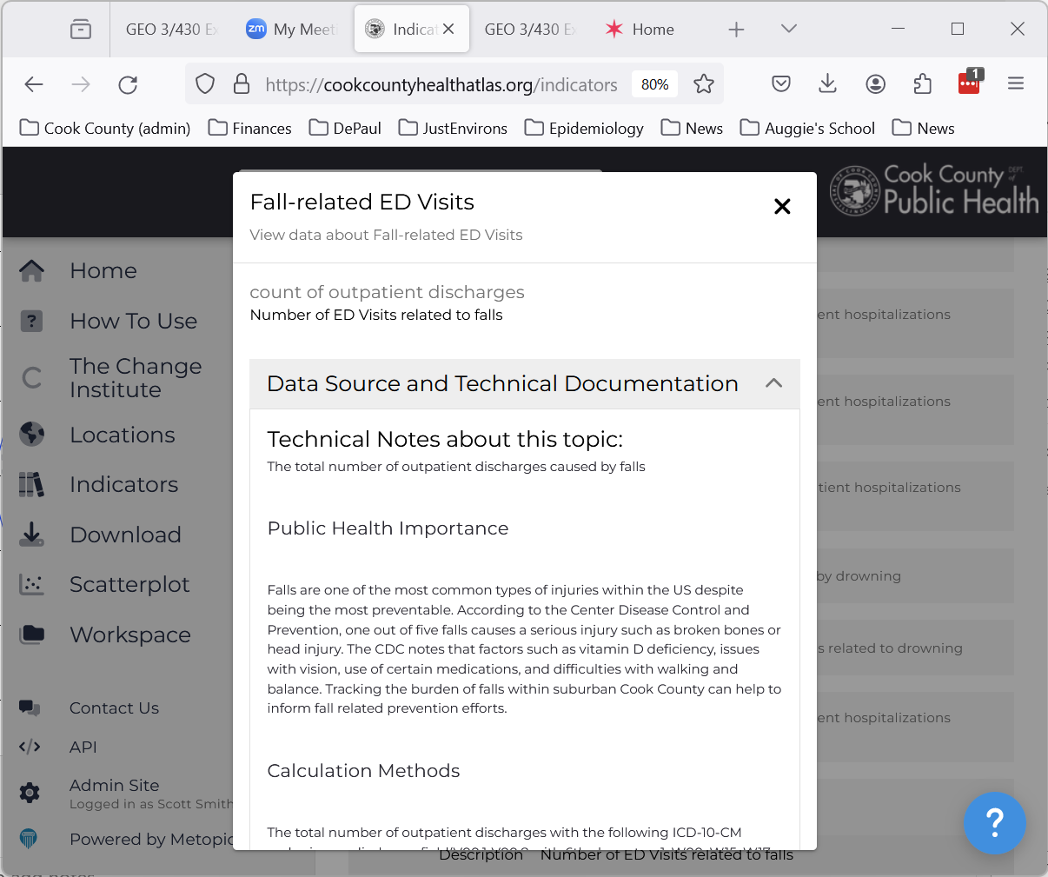
EXPLORING HEALTH INDICATORS
Explore broader patterns of health outcomes, behaviors, and social determinants of health.
Explore health topics, sources
Access
topic-specific pages
Visualize relationships between indicators
Notes:
Access topic-specific pages
In addition to some of the data, maps and tables available on the atlas, CCDPH, over the next several months, will publish topic-specific pages on the platform that provide useful information on emerging health issues using historical and updated information. These topic-specific pages will come in the form of data briefs. Our first in-depth data brief, which will be available this month, will focus on injuries. Drawing from hospitalization and mortality data, the report identifies. In April we will launch our leading cause of death page, which examines trends in mortality across 52 unique causes and population groups. Over the summer we will publish background information concerning our Youth Risk Behavioral and Cook County Health Surveys and related indicators.
Explore data sources, topics
There are multiple ways to search and explore health indicators on the suburban Cook County health atlas. Search form on landing page, review/search indicator list via left navigation bar. When searching an indicator, you can also “view additional information” including the indicator’s description, public health importance, data source, and technical notes such as calculation methods which are important when comparing indicators across different organizations, including the Chicago Department of Public Health.
Visualize (statistical) relationships between indicators
Oftentimes there is a need to better understand the statistical relationships between indicators on the atlas. Knowing how, for example, median household income (or perhaps other social determinants of health), is associated with heart disease or other health outcomes and behaviors. The scatterplot tool on the health atlas allows people to examine such relationships, with validation aids to assist with interpretation. For example, the analysis shows that the relationship between heart disease rate and median household income is a highly significant, meaning that changing median household income explains considerable amount of variation in heart disease mortality rate when holding some variables constant, like income, education, and demographics. Heart disease mortality rate tends to decrease by 7.43 for every 10% increase in median household income.

Slide 12
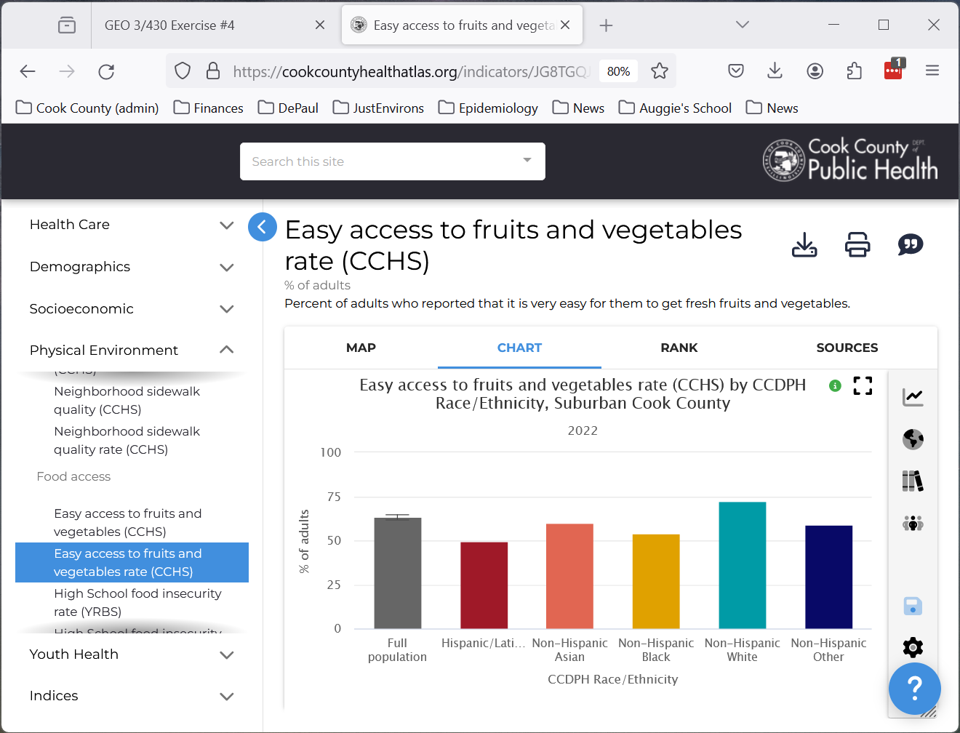
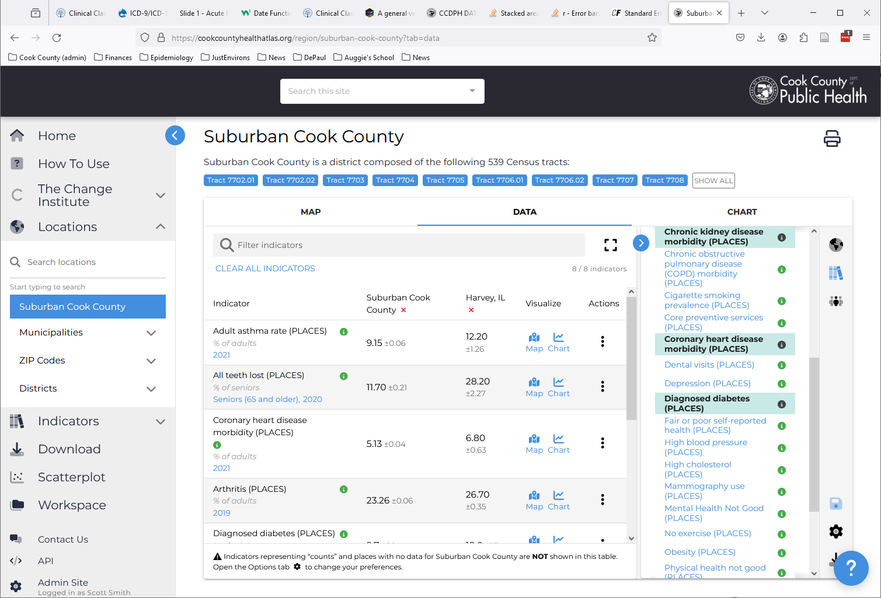
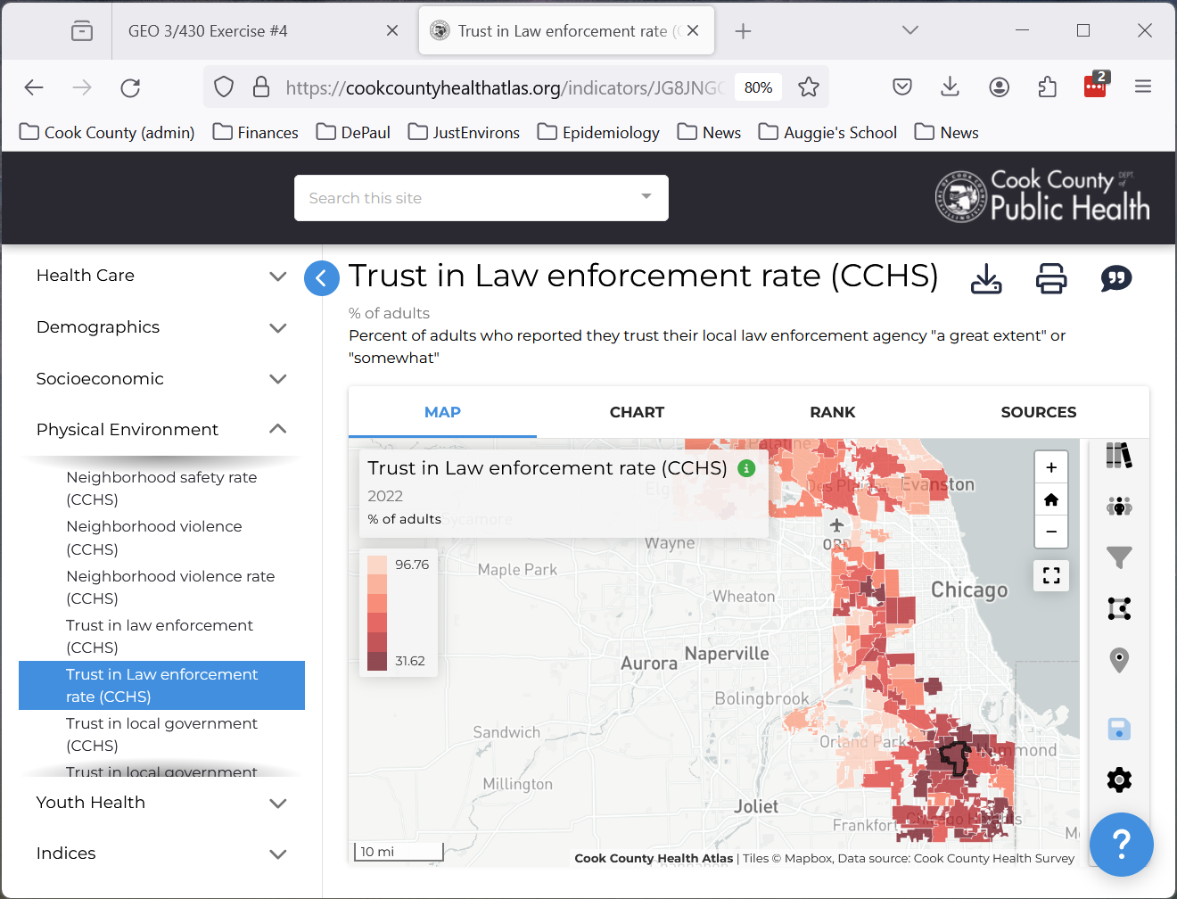
GRANT WRITING & FUNDRAISING
Demonstrate need and/or build a compelling case for the potential impact of proposed initiatives.
Create custom
maps, tables, and charts
Stratify indicators by group
Download data
Notes:
Stratify indicators by group
Your organization may find it meaningful to examine health-related outcomes across different population groups—i.e., stratify by race, ethnicity, sex, and/or age group—to identify patterns within the populations you serve. For many indicators, it is possible to make these comparisons, especially across suburban Cook County. For example, the Cook County Health Survey asks adults the extent to which they have access to fresh fruits and vegetables. The atlas can visualize these patterns by municipality as well as to create a chart that stratifies this same indicator by race, ethnicity at the suburban Cook County level.
Create custom maps, tables, and charts
The health atlas displays default maps, tables, and charts but it is also possible to customize these displays in ways that are relevant to the specific grant proposal. For example, imagine that your organization is concerned about the level of trust in law enforcement among adult residents within south suburban Cook County municipalities based on 2022. In map settings, it is possible, to change some settings (e.g., color scheme, contrast, highlighted places) to make the map more readable and help focus attention to specific communities. The custom map can then be downloaded as an image for import into a grant proposal.
Download data
Similarly, you can create custom tables for select geographies and indicators that can be downloaded into Excel and/or Word. This figure shows prevalence of particular health outcomes for Harvey, IL compared with suburban Cook County.

Slide 13
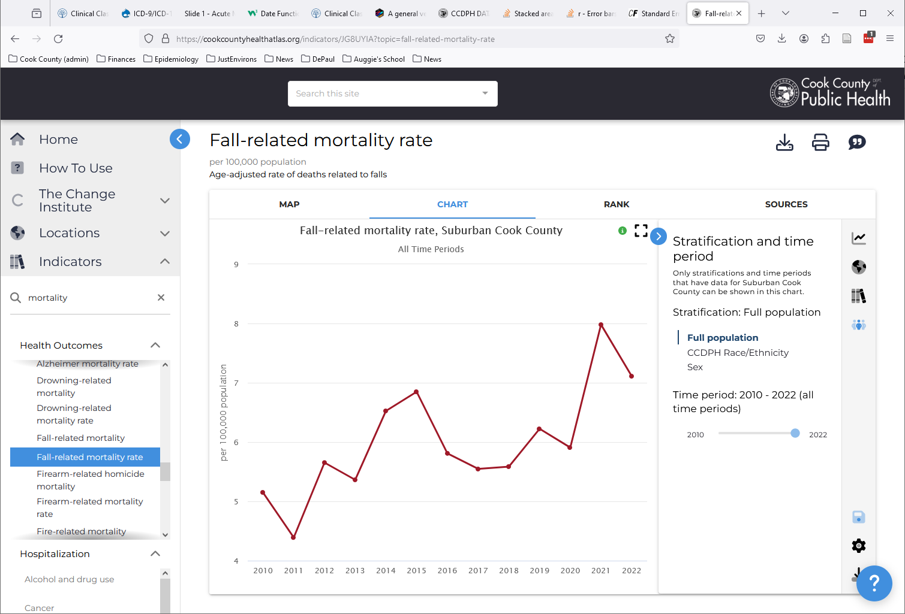
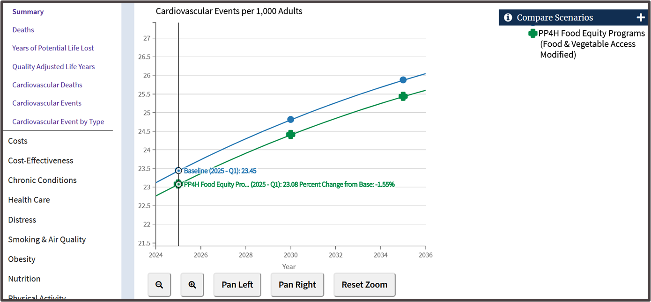
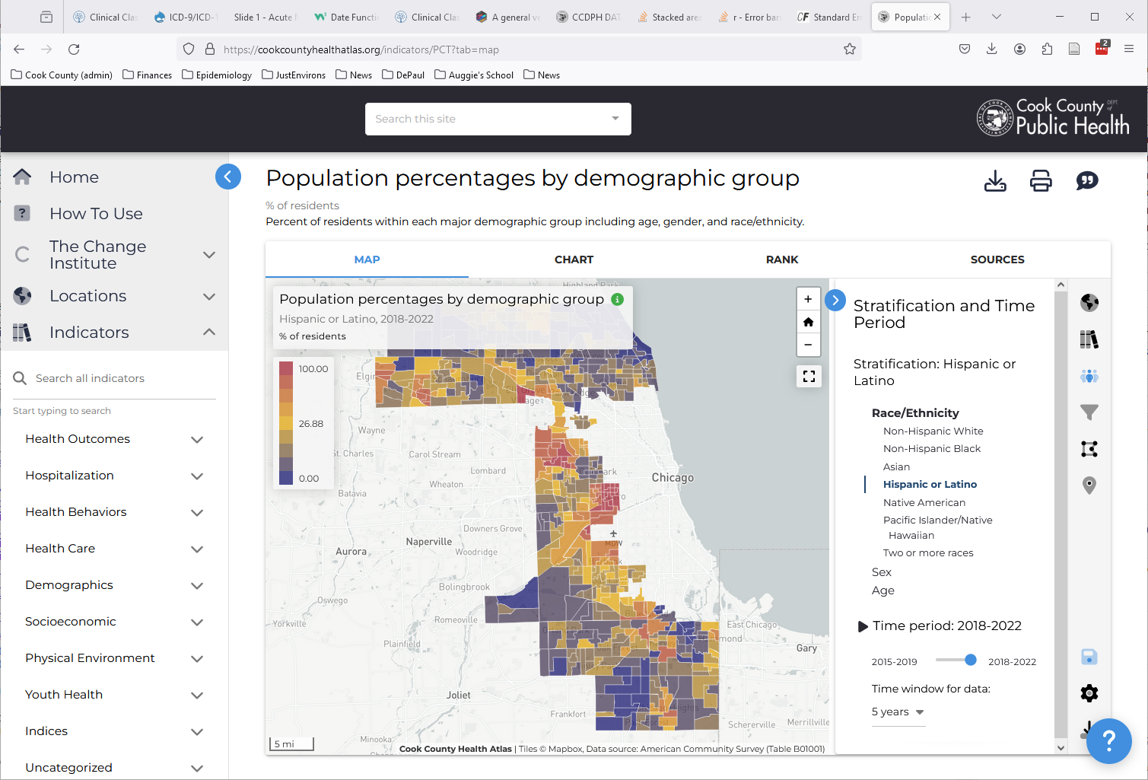
TIME PERIOD COMPARISONS
Monitoring changes over time to identify community trends and evaluate program effectiveness.
Changes in population composition over time
Changes in health outcomes over time
Evaluate programs and/or projects
Notes:
Changes in health outcomes over time
By default the atlas displays the latest data for each indicator. However, it may be important for your organization to examine trends over time to better understand the trajectory of the health outcome or behavior, whether it is trending up or down. The atlas allows users to create line charts over time for many of the indicators to better monitor these trends.
Changes in population over time
The atlas includes the most up-to-date population data from the US Census and similar data over time. Atlas users can examine changes in population composition within suburban Cook County or even the neighborhood (e.g., census tract) level.
Evaluate programs and/or projects
The atlas can be used to access baseline health conditions that can be combined with organization-specific outreach program data, and academic research, to estimate project impact. One example of this is the work CCDPH carried out with PP4H a couple years ago.

Slide 14
NEXT STEPS
Visit this web page to step through content presented during this workshop and other material (including module 3). The web page includes videos and links to other useful, atlas-related resources.
Atlas workspaces can be provided to participants who wish to save their custom maps, tables, charts, and other insights.
Notes:
Next steps
-interest in advanced webinar that focuses on third module
- survey to help develop format of data ambassador

Slide 15
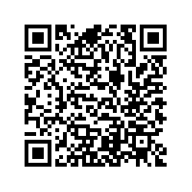
QR Survey Code
Notes:
Next steps
-interest in advanced webinar that focuses on third module
- survey to help develop format of data ambassador

Slide 16

POTENTIAL USES OF HEALTH INDICATOR DATA
Community-based organizations help bridge the gap between public health data and community action.
1
Identify Health Issues
Explore broader patterns of disease prevalence, health disparities, and social determinants of health
2
Grant Writing & Fundraising
Demonstrate need and/or build a compelling case for the potential impact of proposed initiatives
3
Monitor Changes
Monitoring changes over time to identify community trends and evaluate program effectiveness.
Notes:
Working with community health colleagues including Sierra, Ed, and Alyssa, and to the information community groups provided CCDPH via a survey of data practices, we identified a few ways that health indicator data may be of use to community-based organizations: (1) identify health issues; (2) grant writing and fundraising; (3) monitor changes.

Slide 17
